Slide 1
Software as a Service(SaaS)

Slide 2
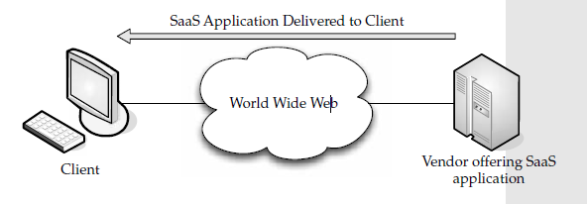
SaaS Definition
SaaS (Software as a Service) is an application hosted on a remote server and accessed through the Internet.
Notes:
Each mail service meets the basic criteria: the vendor (Microsoft, Yahoo, and so on) hosts all of the programs and
World Wide Web Client Vendor offering SaaS application SaaS Application Delivered to Client data in a central location, providing end users with access to the data and software, which is accessed across the World Wide Web.

Slide 3
SaaS Definition
SaaS (Software-as-a-Service) is a model of software deployment where an application is hosted as a service provided to customers across the Internet.
By eliminating the need to install and run the application on the customer's own computer, SaaS alleviates the customer's burden of software maintenance, ongoing operation, and support.
Conversely, customers relinquish control over software versions or changing requirements; moreover, costs to use the service become a continuous expense, rather than a single expense at time of purchase.

Slide 4
SaaS Definition
SaaS service through the Gartner Group as follows:
“software that is owned, delivered and managed remotely by one or more providers. The provider delivers an application based on a single set of common code and data definitions, which are consumed in a one-to-many model by all contracted customers, at anytime on a pay-for-use basis, or as a subscription based on usage metrics.”

Slide 5
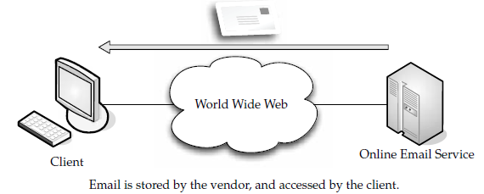
Example
web-based email service
like Microsoft (Hotmail), Google (Gmail), and Yahoo! (Yahoo Mail)
SalesForce.com
EyeOS
… etc

Slide 6
Traditional Software Model
large upfront licensing costs
annual evergreen support costs
annual renewal for upgrades and support
Increasing the number of users may raise the base cost of the package
requires hardware deployment, servers, backup and network provisioning in order to accommodate the number of users on and off-campus.
Security architecture protect this valuable resource from unauthorized access

Slide 7
Traditional Software Model
tend to be highly customizable
on-going maintenance and management of the application
providing the logical and physical security
offering end-user training and support

Slide 8
Software-as-a-Service (SaaS) Model
based on a recurring subscription fee
typically pay as you go model
costs are directly aligned with usage
does not require any hardware and can run over the existing Internet access infrastructure
support, training, infrastructure and security risks- all by SaaS vendor
provides reserve capacity to handle any spikes in usage, outages or network mishaps and to do this continuously, globally and securely

Slide 9
SaaS vs. ASP(Application Service Provider)
ASP applications are traditional single-tenant applications but hosted by a third party. They are client-server applications with HTML front ends added to allow remote access to the application.
The applications are hosted by third-parties who ordinarily do not have specific application expertise.
The applications are not written as net-native applications. As a result, the performance may be poor and application updates are no better than self-managed premise-base applications.
By comparison,
SaaS applications are multi-tenant applications, hosted by a vendor that has all the application expertise and they have been designed as net-native applications that get updated on an on-going basis.

Slide 10
SaaS Categories
Line of business services
These are business solutions offered to companies and enterprises. They are sold via a subscription service. Applications covered under this category include business processes, like supply-chain management applications, customer relations applications, and similar business-oriented tools.
Customer-oriented services
These services are offered to the general public on a subscription basis. More often than not, however, they are offered for free and supported by advertising. Examples in this category include the web mail services, online gaming, and consumer banking, among others.

Slide 11
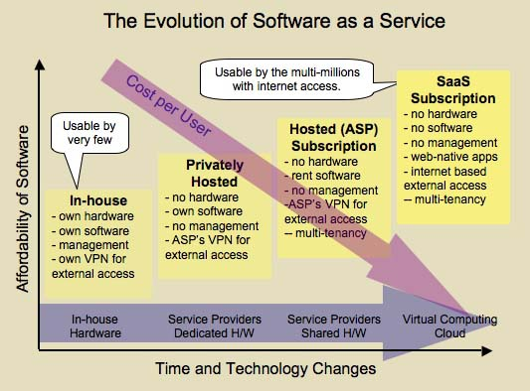
Evolution of SaaS

Slide 12
SaaS Key Characteristics
Network-based access to, and management of, commercially available software.
Activities managed from central locations rather than at each customer's site, enabling customers to access applications remotely via the Web.
Application delivery typically closer to a one-to-many model (single instance, multi-tenant architecture) than to a one-to-one model, including architecture, pricing, partnering, and management characteristics.
Centralized feature updating, which obviates the need for end-users to download patches and upgrades.

Slide 13
SaaS other Characteristics
Modest software tools
The SaaS application deployment requires a little or no client side software installation, which results in the following benefits:
No requirement for complex software packages at client side
Little or no risk of configuration at client side
Low distribution cost
Efficient use of software licenses
Platform responsibilities managed by provider
All platform responsibilities such as backups, system maintenance, security, hardware refresh, power management, etc. are performed by the cloud provider.
Multitenant solutions
The design principles of a multi-tenant system offer a high level of maintainability. For example, if a customer requests for few additional fields in one of the pages you can easily add them through custom field’s module.

Slide 14
Advantages of SaaS
Cloud User Advantages
· Offsite deployment
· Low overhead or low costs
· Decentralized
· Customizable
· On the fly pay as u go

Slide 15
Advantages of SaaS
Cloud Provider Advantages
· Application as a service
· Scalable applications
· High customization
· Highly stable & common base code
· Easy maintenance
· Maximum efficiency
· Flexible costs based on usage

Slide 16
Disadvantages of SaaS
Security
Latency issue
Total Dependency on Internet
Switching between SaaS vendors is difficult

Slide 17
Challeges of SaaS
Controllability
Visibility and Flexibility
Security and Privacy
High performance and Availability
Integration and Composition
Standards

Slide 18
Scalability & Elasticity
What is scalability ?
A desirable property of a system, a network, or a process, which indicates its ability to either handle growing amounts of work in a graceful manner or to be readily enlarged.
What is elasticity ?
The ability to apply a quantifiable methodology that allows for the basis of an adaptive introspection with in a real time infrastructure.
Scalability adapts only to the "workload increase" by "provisioning" the resources in an "incremental" manner.
Elasticity adapts to both the "workload increase" as well as "workload decrease" by "provisioning and deprovisioning" resources in an "autonomic" manner.
But how to achieve these properties ?
Dynamic provisioning
Multi-tenant design

Slide 19
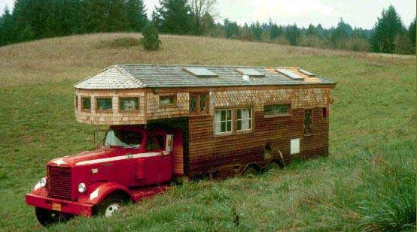
Dynamic Provisioning
What is dynamic provisioning ?
Dynamic Provisioning is a simplified way to explain a complex networked server computing environment where server computing instances are provisioned or deployed from a administrative console or client application by the server administrator, network administrator, or any other enabled user.

Slide 20


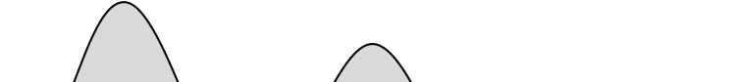

Dynamic Provisioning
In traditional computing model, two common problems :
Underestimate system utilization which result in under provision
Loss Revenue
Resources
Capacity
Resources
Demand
Capacity
1
2
3
Demand
Loss Users
Resources
Capacity
1
2
3
Time (days)
Demand
1
2
3

Slide 21
Dynamic Provisioning
Overestimate system utilization which result in low utilization
How to solve this problem ??
Dynamically provision resources
Capacity
Resources
Unused resources
Demand
Time

Slide 22
Dynamic Provisioning
Cloud resources should be provisioned dynamically
Meet seasonal demand variations
Meet demand variations between different industries
Meet burst demand for some extraordinary events
Resources
Capacity
Resources
Capacity
Demand
Demand
Time
Time

Slide 23
Multi-tenant Design
What is multi-tenant design ?
Multi-tenant refers to a principle in software architecture where a single instance of the software runs on a server, serving multiple client organizations.
With a multi-tenant architecture, a software application is designed to virtually partition its data and configuration thus each client organization works with a customized virtual application instance.
Client oriented requirements :
Customization
Multi-tenant applications are typically required to provide a high degree of customization to support each target organization's needs.
Quality of service
Multi-tenant applications are expected to provide adequate levels of security and robustness.

Slide 24
Existing SaaS Maturity Models
Saas Simple Maturity Model by Microsoft Corporation (2006)
Model by Forrester Research (2008)

Slide 25
SaaS Simple Maturity Model (Microsoft, 2006)
Model on Single Packaged Application
Focused on SaaS Application Architecture
Three Key Attributes of an Architecture:
Configurability: Metadata used to configure the way the application behaves for customers
Multi-tenant Efficiency: Maximizing the sharing of resources across tenants
Scalability: Maximizing concurrency, resource efficiency

Slide 26
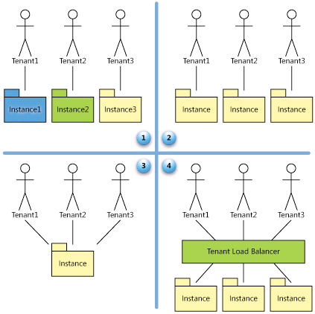
SaaS Simple Maturity Model: Four Levels
Level 1: Ad Hoc/Custom
Level 2: Configurable
Level 3: Configurable &
Multi-Tenant-Efficient
Level 4: Scalable,
Configurable, Multi-
Tenant-Efficient

Slide 27
Level 1: Ad Hoc/Custom
resembles the conventional ASP (application service provider) software delivery model
each client has his/her own personalized version of a hosted application, which he/she runs an instance of the software app on the host’s servers.
In terms of architecture, software at level I maturity closely resembles traditional line-of-business software, in which multiple clients or customers within a single organization are able to form a type of connection to a single instance running on the server
conventional client-server apps can be relocated to a cloud-based model usually at the initial level of maturity, and with lesser development effort or without having to re-architect the whole system

Slide 28
Level 2: Configurable
SaaS vendor hosts a totally different instance of the SaaS application for each tenant
each instance is personally customized for each tenant, all instances at this level utilize similar code implementation
the vendor meets the needs or requirements of the customer by offering in-depth configuration options that enable the customer to alter the look of the application as well as its behavior to its users
repositioning a conventional application as cloud-based at this maturity level may require additional re-architecting compared to the previous level

Slide 29
Level 3: Configurable & Multi-Tenant-Efficient
Level III maturity is characterized by the vendor running a single instance serving each client with configurable metadata to provide unique, customized user experience and unique feature set
This eliminates the need for server space to accommodate the many instances, allowing for efficient use of scarce computing resources than level II, thus, translating to lower costs.
disadvantage : limited scalability

Slide 30
Level 4: Scalable,Configurable, Multi-Tenant-Efficient
vendor hosts several clients on a load-balanced group of identical instances, but with each client’s data stored separate, and configurable metadata offering each customer a phenomenal user experience and unique feature set
Can be scaled to a large number of clients, as the number of instances and servers on the backend can be adjusted to meet demand

Slide 31
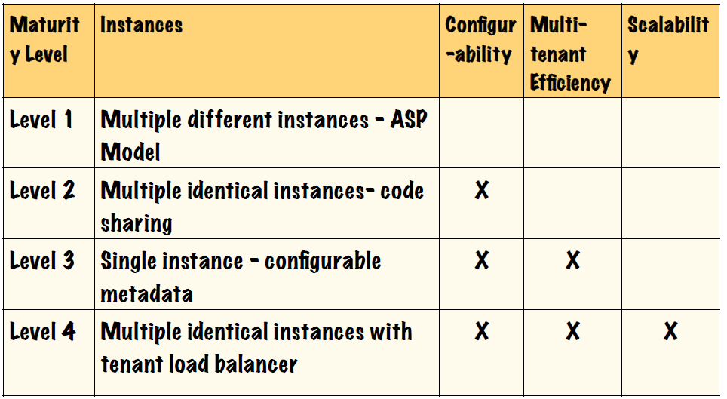
Summary

Slide 32
SaaS Maturity Model (Forrester, 2008)
Evolution Model on SaaS Applications: guidance on realistic strategy transformation for software vendors and services providers considering an SaaS business model
Focused on SaaS Application Domain

Slide 33
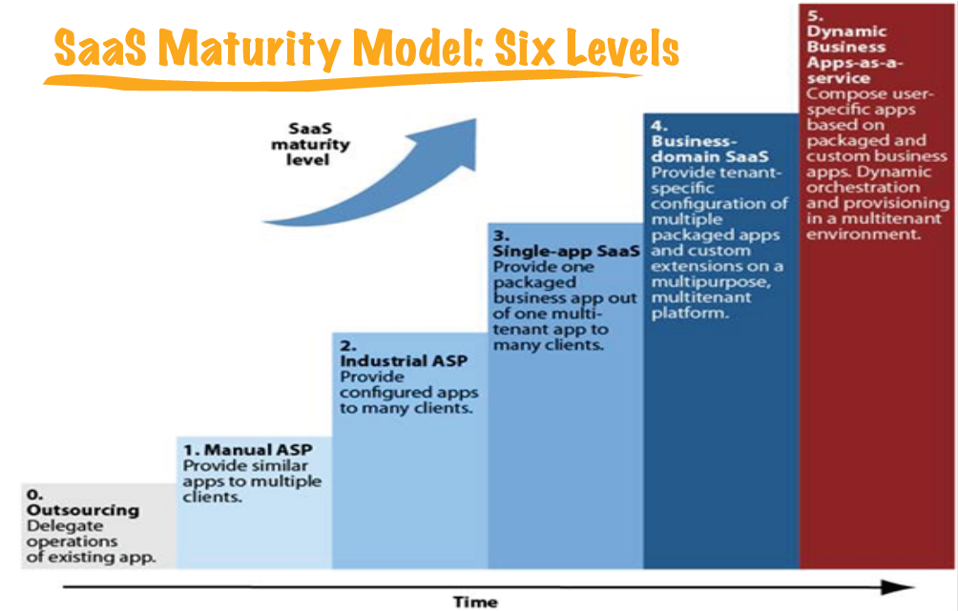
SaaS Maturity Model (Forrester, 2008)

Slide 34
Level 0: Outsourcing
A service provider operates a major application or a unique application landscape for a large enterprise customer
The outsourcing company can't leverage the application for a second customer
Does not really qualify as SaaS

Slide 35
Level 1: Manual ASP
A service provider runs packaged applications for multiple midsize enterprises
Each client usually has a dedicated server running its instance of the application and is able to customize the installation in the same way as self-hosted applications
Target midsize companies
Similar to level 1 (Ad-hoc/custom) of Microsoft’s model

Slide 36
Level 2: Industrial ASP
A service provider runs identical packaged applications with customer-specific configurations to many customers
Cut the operating costs of applications to a minimum
Usually applicable to small and midsize business customers
Similar to level 2 (Configurable) of Microsoft’s model

Slide 37
Level 3: Single-app SaaS
An SaaS provider provides one packaged business application with Web-based user interface to many customers (e.g. Salesforce’s initial CRM application)
Customization is restricted to configuration
Focus on small and midsize business customers
Similar to level 3 (Configurable & Multi-Tenant-Efficient) of Microsoft’s model

Slide 38
Level 4: Business-domain SaaS
An advanced SaaS vendor provides not only a well-defined business application but also a platform for additional business logic
Single application of level 3 complemented with third-party packaged SaaS solutions and custom extensions
Satisfy the requirements of large enterprises
Similar to level 4 of Microsoft’s model, yet with extension of composition with other applications

Slide 39
Level 5: Dynamic Business-domain Apps-as-a-Service
An advanced SaaS vendors coming provides a comprehensive application and integration platform on demand, which they will pre-populate with business applications or services
New paradigm: design for people, build for change
Composition of user-specific business applications on various levels in a multi-tenant environment
The resulting process agility will attract everyone, including large enterprise customers

Slide 40
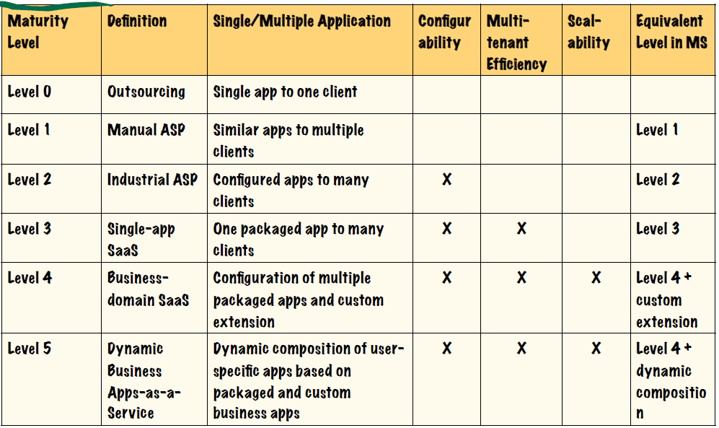
Summary

